Slide 1

The Development of front-end
Roy Aardenburg, Damian Pietrzak, Kjell Durge

Slide 2

Content page
HTML
CSS
Javascript
CONCLUSION

Slide 3


HTML
What is HTML?
What is the function of this language?
Where can you find it?
Will it be useful in the future

Slide 4
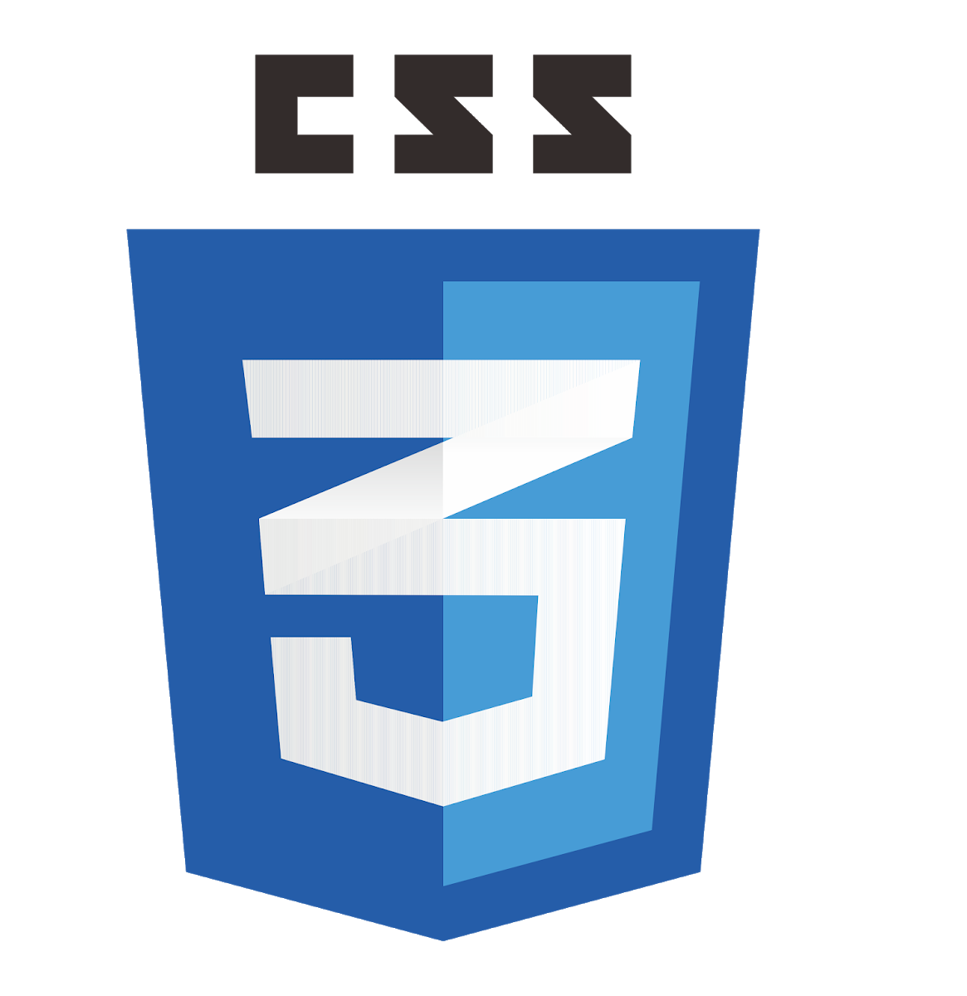
CSS
What is it?
What is it used for?
How is it used?
Is it still popular/being used?

Slide 5

Javascript
What is JavaScript
What is the function of this language?
When was it invented?
Is it still a primary used language?

Slide 6

Conclusion

